Slide 1


LogicST: A Logical Self-Training Framework for Document-Level Relation Extraction with Incomplete Annotations
Shengda Fan, Yanting Wang, Shasha Mo, Jianwei Niu
The 2024 Conference on Empirical Methods in Natural Language Processing
Beihang University
Notes:
Hello everyone, I’m Shengda Fan from Beihang University. I’m going to present our paper 《LogicST: A Logical Self-Training Framework for Document-Level Relation Extraction with Incomplete Annotations》, which is accepted in EMNLP 2024 as a poster paper.

Slide 2
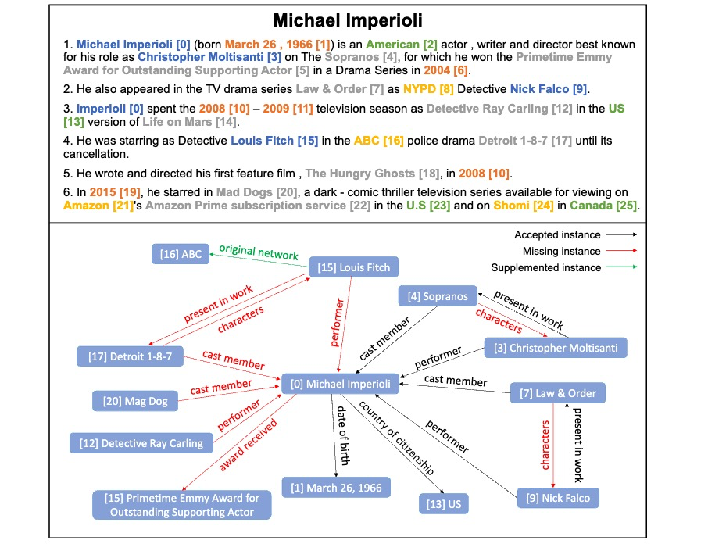
Motivation
Fully labeling datasets of Document-level Relation Extraction is very difficult.
Notes:
Unlike sentence-level relation extraction, which focuses on individual entity pairs, document-level relation extraction is challenged by the vast number of potential entity pairs. This number increases quadratically /kwɒˈdrætɪkli/ with the number of entities, making it nearly impossible for annotators to carefully verify the validity of each triplet. Although semi-automatic strategies, such as the recommend-revise annotation method, can alleviate annotators’ workload, they still fail to provide gold-quality datasets. Consequently, these datasets are prone to contain numerous false negative samples. For example, over 60% triplets are not annotated in DocRED. Therefore, training models from incompletely annotated datasets is crucial and practical for DocRE.

Slide 3
Motivation
Recent Work:
Negative Sampling
Empirical analysis of unlabeled entity problem in named entity recognition
Positive-Unlabeld Learning
A unified positive-unlabeled learning framework for document-level relation extraction with different levels of labeling
A positive-unlabeld metric learning framework for document-level relation extraction with incomplete labeling
Sub-Symbolic Self-Training
Crest: A class-rebalancing self-training framework for imbalanced semi-supervised learning
Class-adaptive self-training for relation extraction with incompletely annotated training data
Notes:
Existing efforts to address incomplete labeling problems in DocRE can be categorized into: negative sampling, positive-unlabeled (PU) learning, and sub-symbolic self-training. Negative sampling avoids overfitting to false negatives but fails to effectively utilize the semantic information of unsampled samples. PU learning adjusts the loss weights assigned to relational classes but overlooks the intra-class variability among distinct samples. Sub-symbolic self-training, representing the current state-of-the-art, iteratively re-annotates negative samples, fully utilizing all sample information and accounting for within-class differences. However, it neglects the informative structures between entity pairs, leading to sub-optimal extraction performance and extended training times.

Slide 4
What are we doing diﬀerently?
Symbolic knowledge, such as logical rules, can be utilized as diagnostic tools to identify conflicts between pseudo-labels.
Notes:
To address above three limitations, this work integrates symbolic knowledge into the self-training framework, providing a novel perspective on DocRE with incomplete annotations.
Our key insight is that symbolic knowledge, such as logical rules, can be utilized as diagnostic tools to identify conflicts between pseudo-labels.

Slide 5
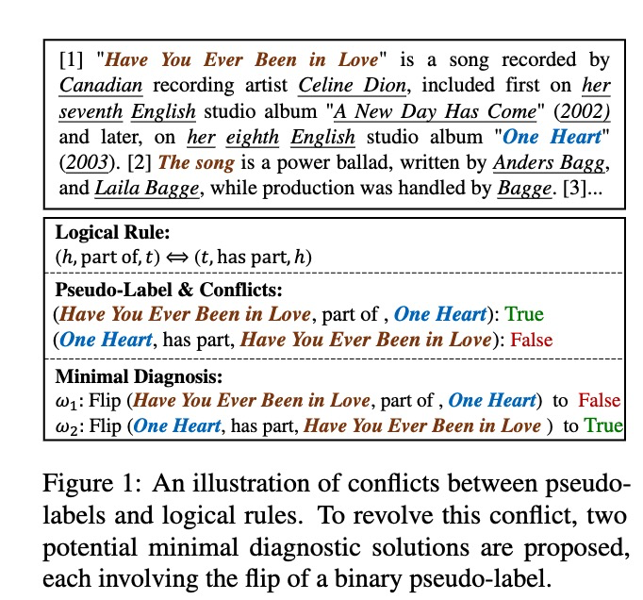
Motivation
Notes:
For example, in Figure 1, there are contradictions such as stating that Have You Ever Been in Love is a part of One Heart, while at the same time claiming that One Heart does not include Have You Ever Been in Love as one of its parts. This inconsistency violates the logical rule that if something is part of another, the reverse must also be true. By adjusting certain pseudo-labels to correct these contradictions, we can improve the accuracy of the pseudo-labels and help reduce the common problem of confirmation bias.

Slide 6
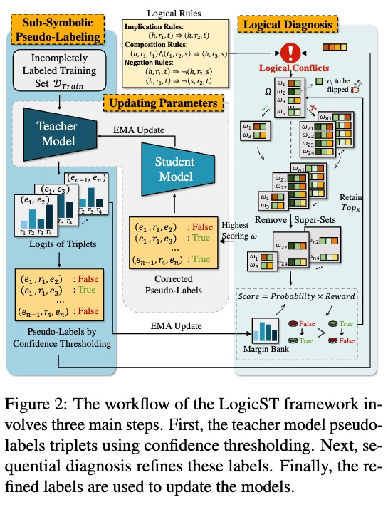
Overview
Notes:
The LogicST framework operates in three main steps. First, the teacher model assigns a score to each candidate triplet and generates pseudo-labels based on a confidence threshold. Next, a sequential diagnosis method is applied to correct the pseudo-labels. Finally, the corrected pseudo-labels are used to optimize the student model, and the exponential moving average of its weights is used to further improve the teacher model.

Slide 7
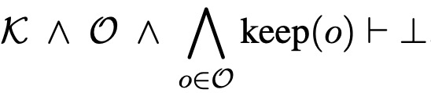
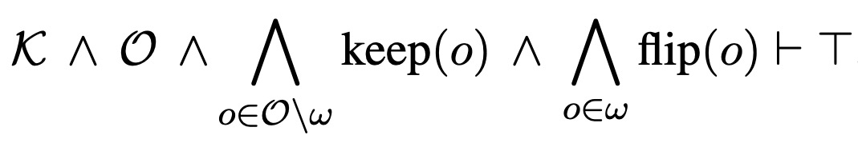
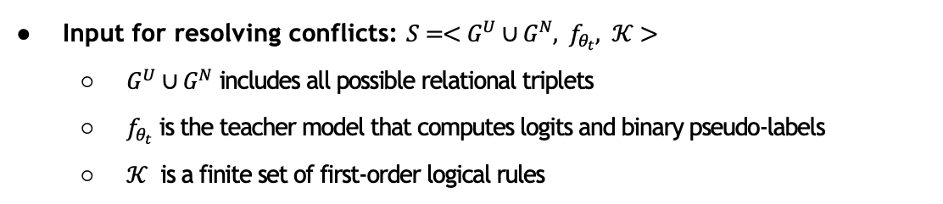
Logical Correction of Pseudo-Labels
Input for resolving conflicts: $S=<G^{U}∪G^{N}, f_{θ_{t}}, 𝒦>$
$G^{U}∪G^{N}$ includes all possible relational triplets
$f_{θ_{t}}$ is the teacher model that computes logits and binary pseudo-labels
$𝒦$ is a finite set of first-order logical rules
Conflicts arise when the pseudo-labels are not compatible with the logical rules
LogicST endeavors to identify and flip a subset of pseudo-labels to resolve conflicts
Notes:
In LogicST, the input for resolving conflicts consists of three components:
GP ∪ and GN – This represents all possible relational triplets.
fθt – This is the teacher model, which computes logits and binary pseudo-labels for all triplets. Each pseudo-label is a key-value pair in the format of the triplet and its corresponding boolean value.
K – This is a set of first-order logical rules that capture the dependencies between different relations. To ensure the quality of these rules, we use a frequency-based method from the development set, which includes rules for implication, composition, and negation.
Conflicts arise when the pseudo-labels O produced by the teacher model are not compatible with the logical rules K.
The predicates keep(·) indicates that we keep the current boolean value of a pseudo-label.
The goal of LogicST is to identify and flip a subset of these pseudo-labels, referred to as ω, to resolve any conflicts that arise. This process is known as diagnosis. By strategically flipping certain labels, we improve the overall consistency and accuracy of the model.

Slide 8
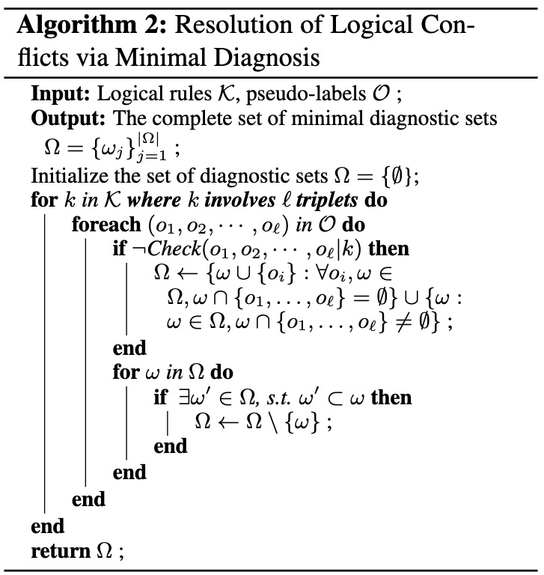
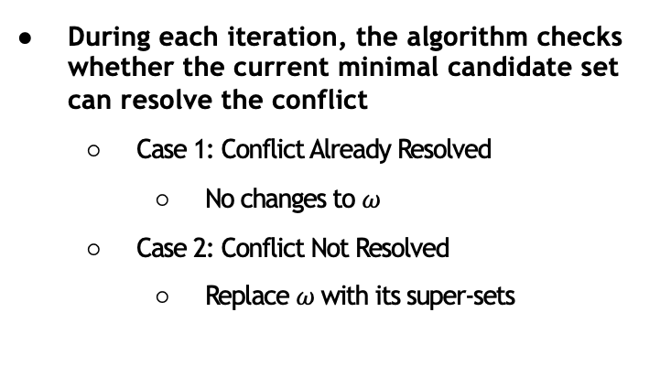
Logical Correction of Pseudo-Labels
During each iteration, the algorithm checks whether the current minimal candidate set can resolve the conflict
Case 1: Conflict Already Resolved
No changes to $ω$
Case 2: Conflict Not Resolved
Replace $ω$ with its super-sets
At the end each iteration, remove any supersets that are redundant to get minimal diagnosis
Notes:
During each iteration, the algorithm checks if the current minimal candidate set, ω, can resolve the conflict between the pseudo-labels, O, and the logical rules, K. This involves assessing whether the intersection of ω with the set of conflicting pseudo-labels from this iteration, represented by {o1, ..., oℓ}, is empty or not. Here's how it works:
Case 1: Conflict Already Resolved If ω contains at least one of the conflicting pseudo-labels, meaning ω ∩ {o1, ..., oℓ} ≠ ∅, then the conflict can already be resolved. In this case, no further changes are needed, and the current set ω is sufficient to address the issue. This is marked by the check symbol (✓) in Figure 1.
Case 2: Conflict Not Resolved If the intersection is empty, meaning ω ∩ {o1, ..., oℓ} = ∅, then the current set ω does not contain any of the conflicting pseudo-labels and cannot resolve the conflict. In this case, the algorithm replaces ω with its supersets. Each superset includes one additional conflicting pseudo-label from {o1, ..., oℓ}. This situation is marked by the cross symbol (✗) in Figure 1.
In essence, the algorithm iteratively adjusts ω by checking if it can resolve the conflict and, if not, expands it until the conflict is addressed.
Once the minimal candidate sets are expanded and evaluated, LogicST proceeds to remove any supersets that are redundant. This ensures that only the minimal diagnosis sets,
those that can resolve the conflict with the fewest changes, remain.

Slide 9
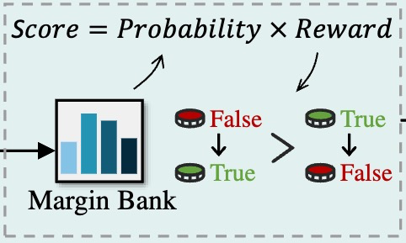
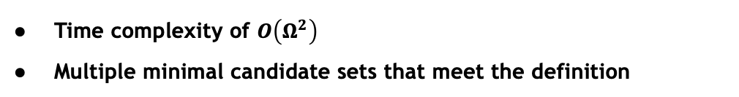
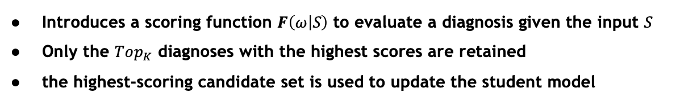
Sequential Diagnosis
Existing problems
Time complexity of $O\left(Ω^{2}\right)$
Multiple minimal candidate sets that meet the definition
Method
Introduces a scoring function $F\left(ω | S\right)$ to evaluate a diagnosis given the input $S$
Only the $Top_{K}$ diagnoses with the highest scores are retained
the highest-scoring candidate set is used to update the student model
Notes:
Although Algorithm 2 can compute all minimal candidate sets, it has a time complexity of O(|Ω|²) in each iteration due to the need to remove non-minimal sets. This becomes impractical when dealing with numerous conflicts. Additionally, as shown in Figure 1, there are often multiple minimal candidate sets that fit the criteria, but only one specific set will be used to flip the pseudo-labels during training.
To tackle these challenges, LogicST introduces a scoring function, F(ω|S), which evaluates a diagnosis ω based on the input S. Specifically, LogicST defines a scoring function that dynamically evaluates the probabilities and rewards of each diagnosis.
After updating the minimal diagnostic sets in each iteration, only the Top K diagnoses with the highest scores are kept, significantly reducing the computation time. Ultimately, the highest-scoring candidate set is used to update the student model, a process known as best-first sampling in model-based diagnosis.

Slide 10
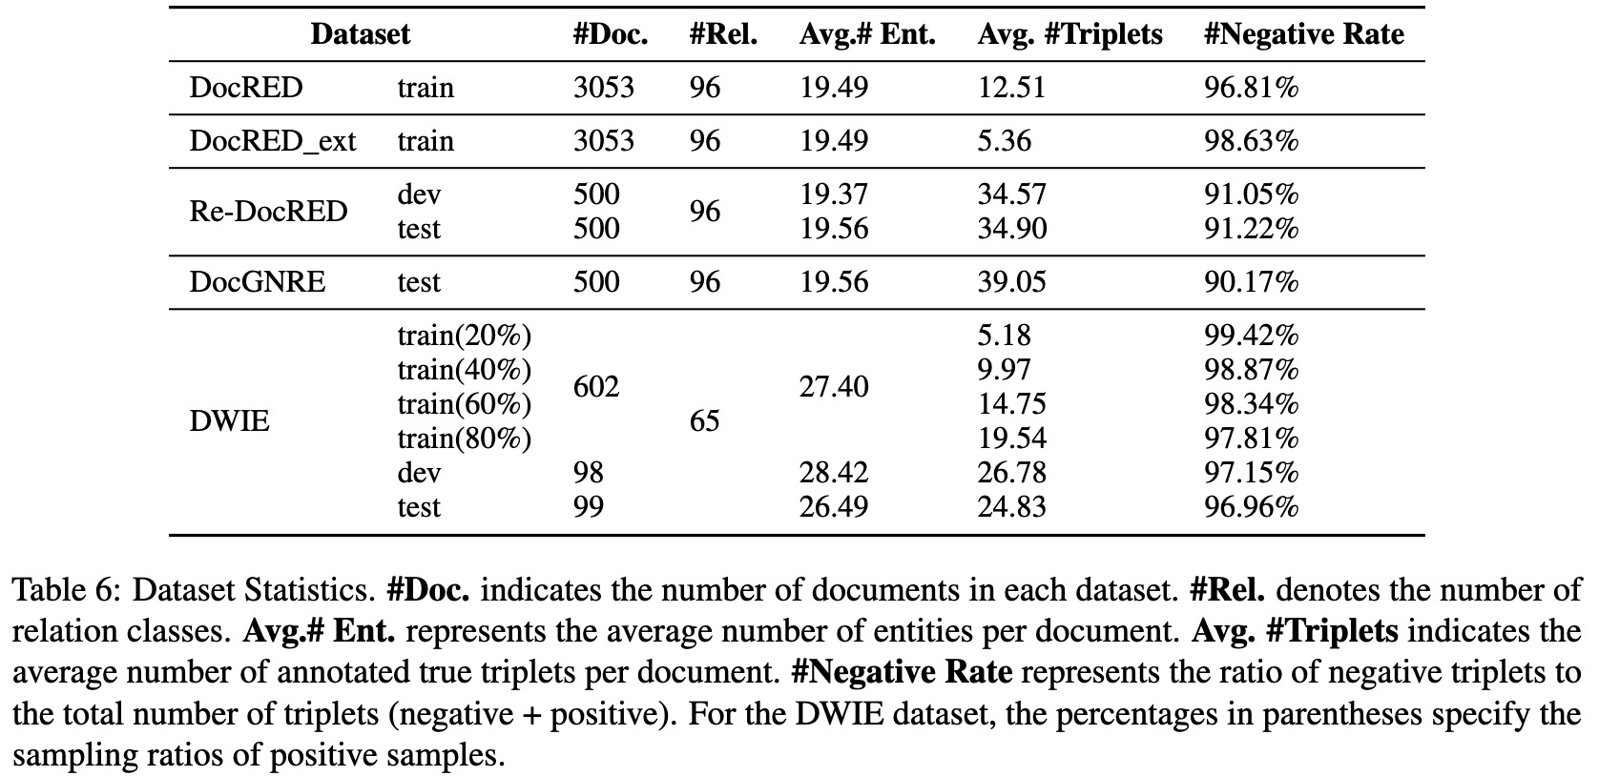
Experimental Setup
Datasets
DWIE
DocRED
Baselines
Vanilla baselines
Negative sampling
PU-learning
Sub-symbolic self-training
Large language models
Logical frameworks for fully supervised settings
Notes:
We compared LogicST against six types of baselines:
Vanilla baselines: These include top-performing models under fully supervised settings, such as GAIN, ATLOP, and KD-DocRE.
Negative sampling methods: This includes techniques like the one proposed by Li et al.
PU learning-based methods: This category includes SSR-PU and P3M approaches.
Sub-symbolic self-training methods: Examples are VST, CREST, and CAST.
Large language model (LLM)-based methods: These include LLaMA2-7B, GPT-3.5, GPT-4, as well as techniques like in-context learning (ICL) for task-specific adaptation, natural language inference (NLI) models for fuzzy matching, and data programming for label denoising.
Logical frameworks for supervised DocRE: This includes approaches like LogiRE, MILR, and JMRL.

Slide 11
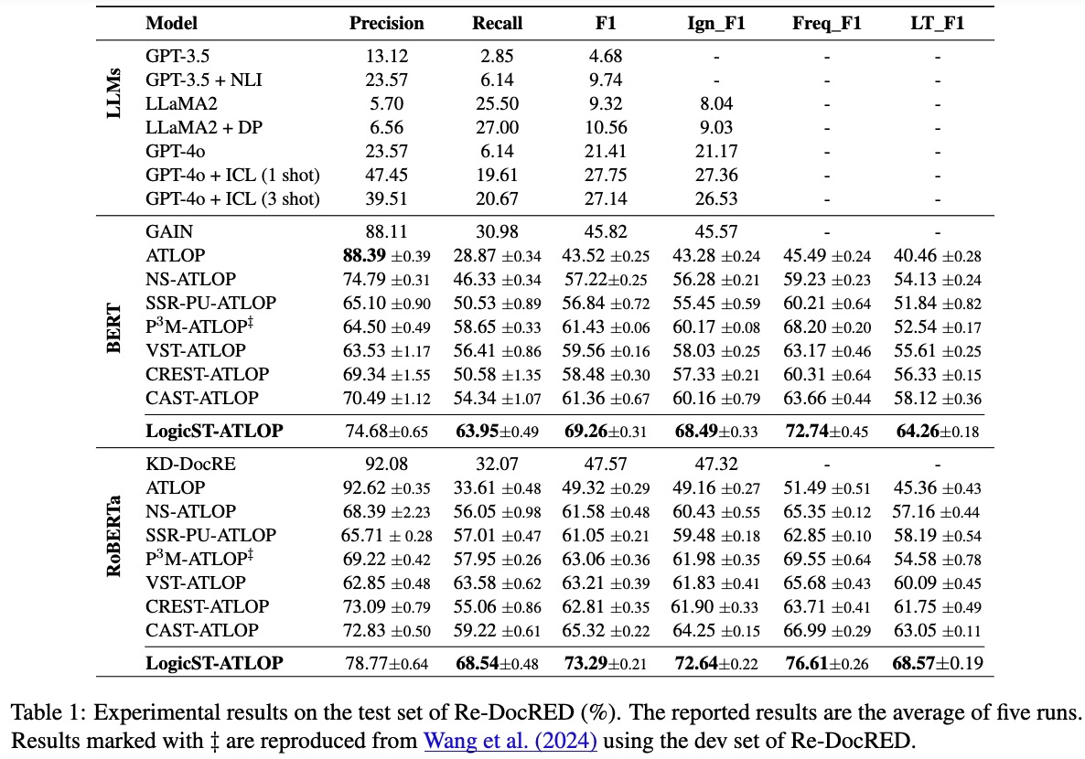
Resutls on DocRED
LLMs perform poorly compared to BERT-based models
LogicST surpasses all baselines by a large margin
LogicST maintains a superior balance between precision and recall
LogicST mitigates the confirmation bias and the class imbalance problem
Notes:
Table 1 shows four key findings from the Re-DocRED’s comparisons:
LLMs underperform: Despite advanced techniques, LLMs struggle with complex reasoning and domain-specific nuances, and adding noisy in-context samples further degrades their performance.
LogicST outperforms all baselines: It achieves a 7.94% absolute F1 improvement over CAST, setting new state-of-the-art results with 69.26% F1 using BERT-base and 73.29% F1 using RoBERTa-large.
Strong balance of precision and recall: LogicST maintains a superior balance between precision and recall, outperforming other weakly-supervised methods.
Symbolic logic improves results: LogicST reduces confirmation bias and addresses class imbalance, improving performance for both frequent and rare relation classes.

Slide 12
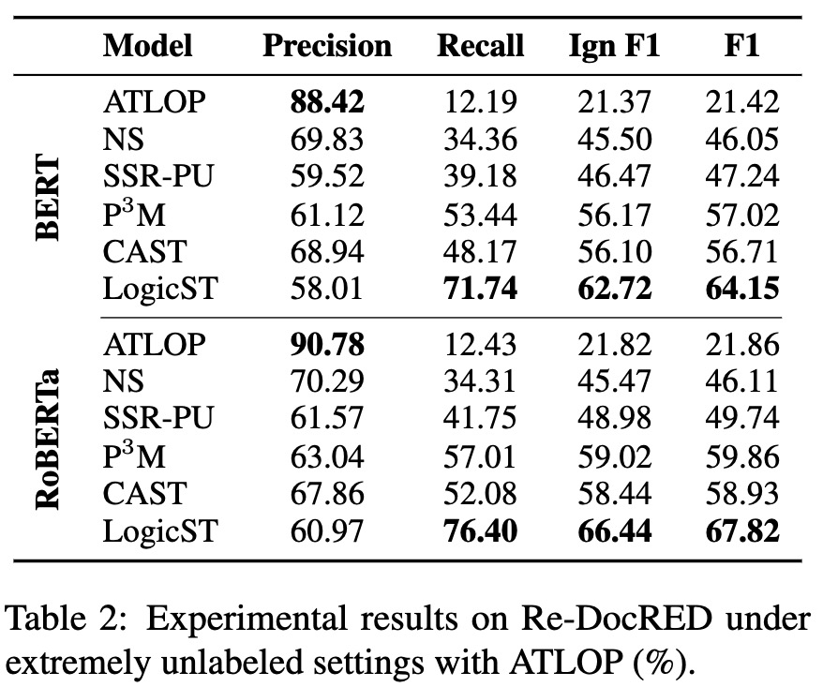
Resutls on DocRED_ext
LogicST framework consistently outperforms all strong baselines
Notes:
Also, we demonstrate that LogicST consistently outperforms all strong baselines under extremly unlabeld settings.

Slide 13
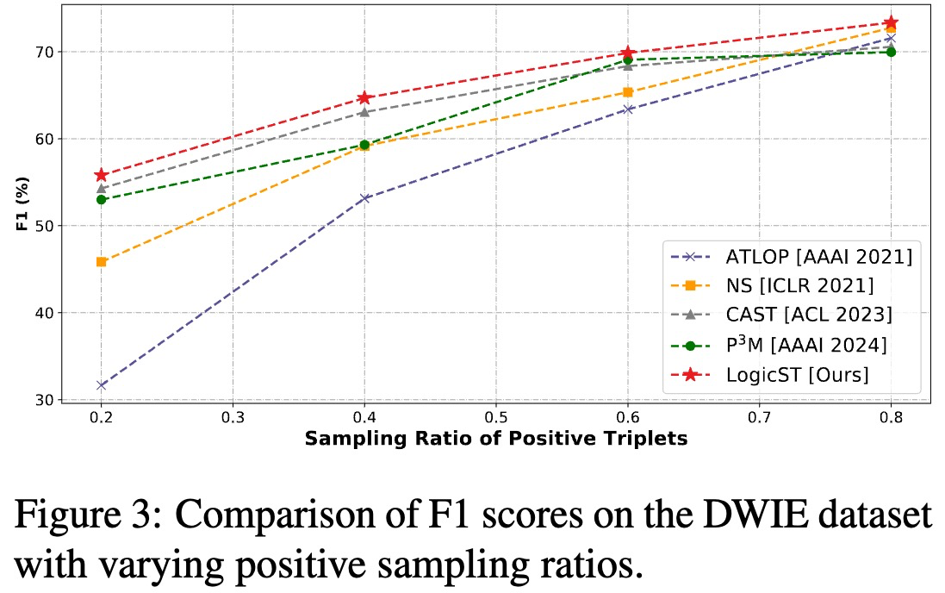
Resutls on DWIE
LogicST consistently surpasses all baseline models across different sampling ratios
Notes:
And LogicST consistently surpasses all baseline models on the DWIE dataset across different sampling ratios. However, the improvement of LogicST is less pronounced on the DWIE dataset compared to DocRED. This difference is due to how the datasets are constructed. The DWIE dataset is generated through uniform sampling, making it simpler, whereas the missing annotations in DocRED come from distant supervision, which introduces biases towards popular classes and entities. As a result, the DWIE dataset is less complex, which narrows the performance gap between different frameworks.

Slide 14
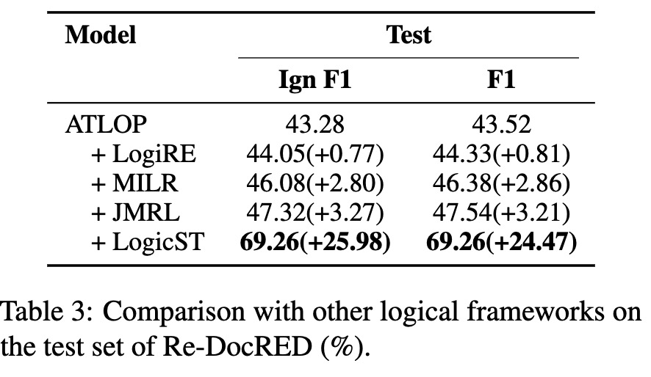
Comparison with Other Logical DocRE Frameworks
LogicST consistently surpasses all other logical frameworks
Notes:
The results in Table 3 demonstrate that the logical frameworks designed under fully supervised-settings only slightly improve the backbone model‘s performance under incomplete annotations, primarily because they rely on noisy labels for calculating the classification loss, which often leads to overfitting. In contrast, LogicST focuses on correcting these noisy labels, resulting in significantly better performance when dealing with incomplete annotations.

Slide 15
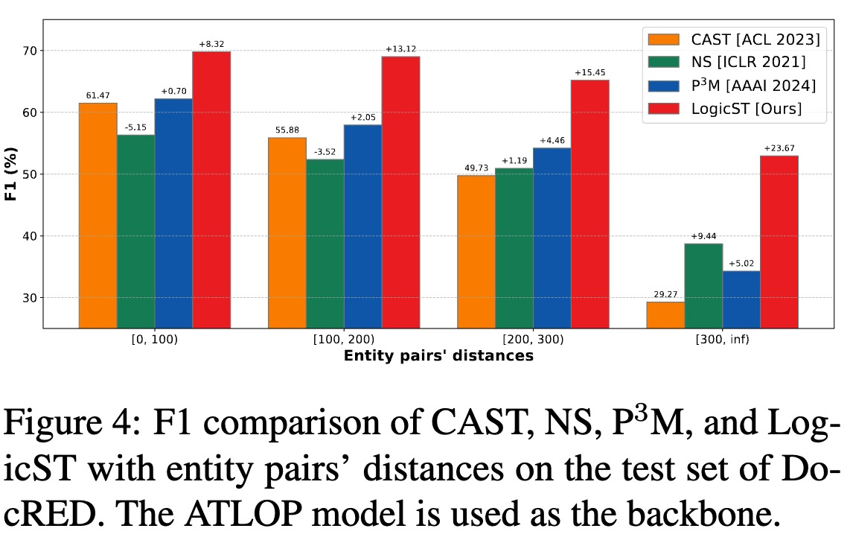
Performance with respect to Entity Pairs’ Distances
LogicST framework consistently outperforms all strong baselines across all groups
Notes:
We analyzed the relation extraction performance by categorizing it into four groups based on the distance between entity pairs to assess the ability to capture long-range dependencies. As seen in Figure 4, the LogicST framework consistently outperforms all strong baselines across all distance groups.

Slide 16
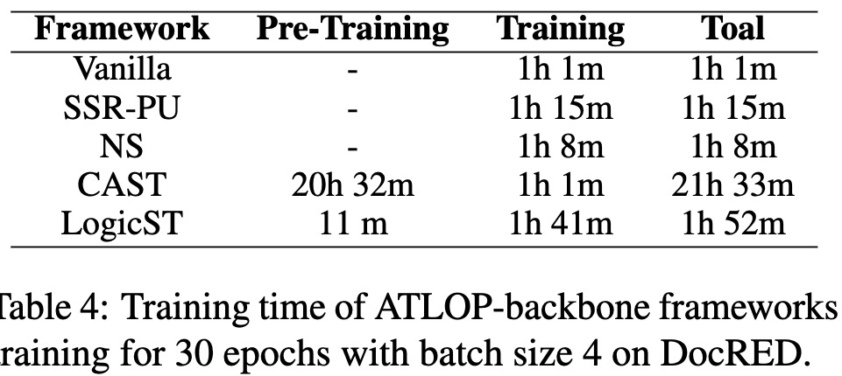
Efficiency Comparison
LogicST is lighter
Notes:
Table 4 presents the training time of various frameworks. As seen, our LogicST framework is lighter than other self training frameworks suchas CAST.

Slide 17
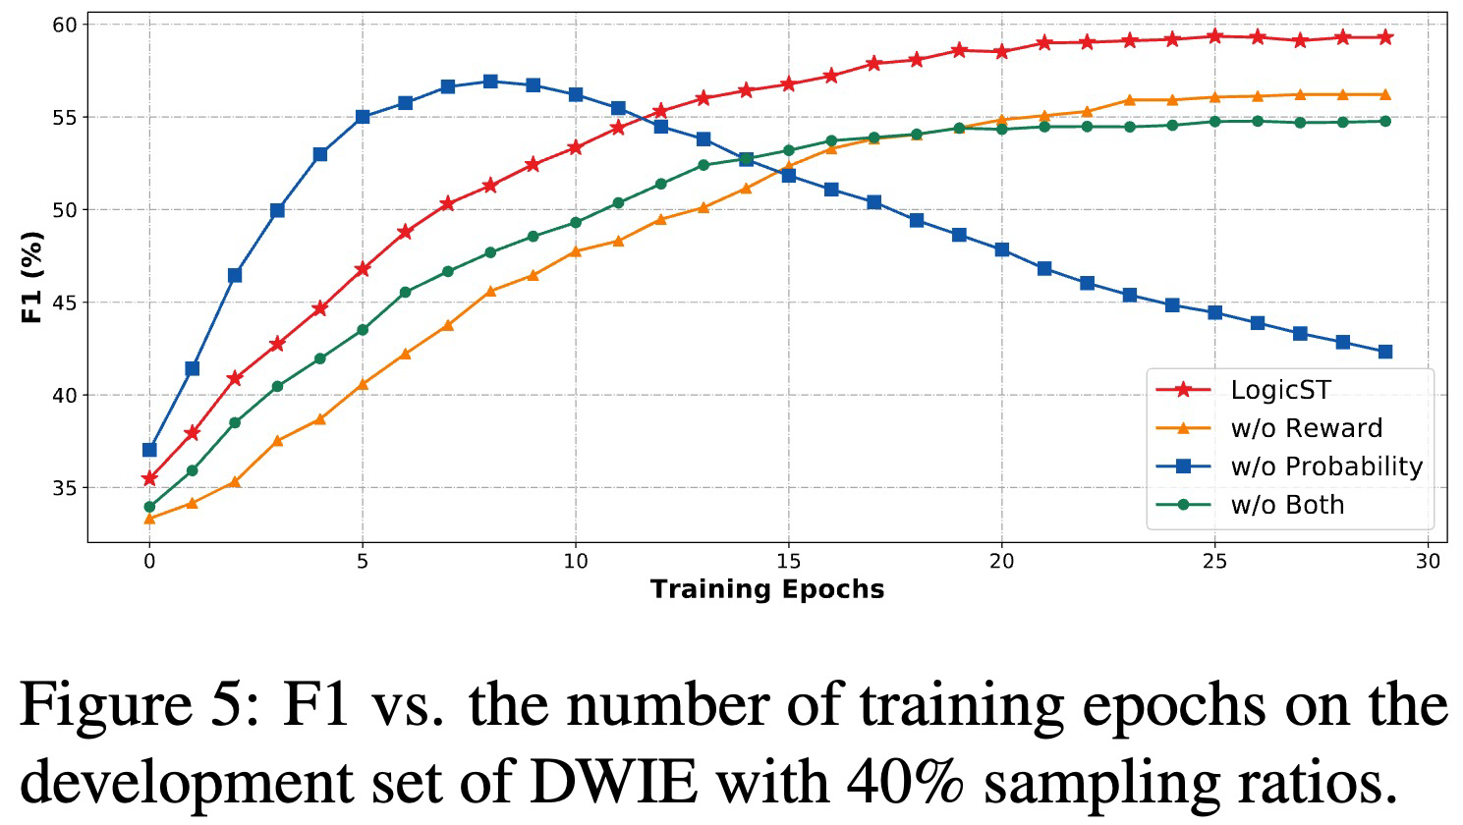
Effect of Scoring Functions
Both components are essential
Notes:
To evaluate the impact of the scoring function, we plotted the F1 scores of different model variants over training epochs, as shown in Figure 5. The results show two key findings:
Without considering the probability of diagnoses, the model struggles with correcting false positives. Initially, it improves by addressing false negatives, but later overfits to new errors, leading to a performance decline.
Without considering the reward of diagnoses, the framework fails to correct enough false negatives during early training, resulting in sub-optimal performance overall.

Slide 18
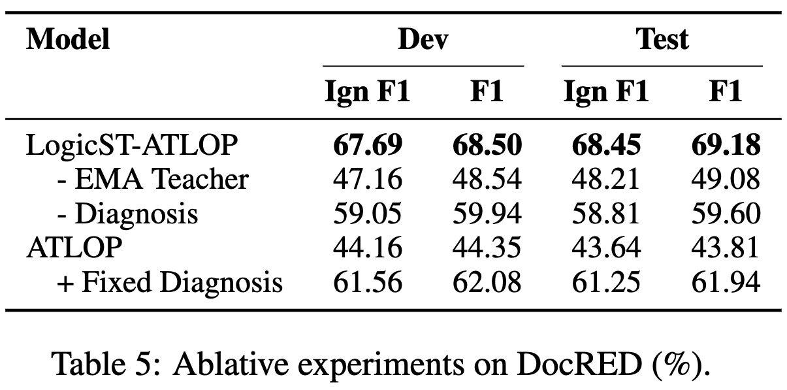
Ablation Study
EMA teacher is essential for mitigating the impact of noisy labels and stabilizing the training process
Logical diagnosis significantly improves the quality and coverage of pseudo-labels
Fixed diagnosis fails to account for additional false negatives during training
Notes:
We conducted an ablation experiment to evaluate the effectiveness of LogicST’s components. Additionally, we introduced a baseline called "Fixed Diagnosis," which uses implication and composition rules to complement the training labels before the two-stage training, keeping these labels fixed throughout the process. The results in Table 5 highlight three key points:
The EMA teacher is crucial for reducing the impact of noisy labels and stabilizing the training process.
Logical diagnosis significantly enhances the quality and coverage of pseudo-labels, boosting performance.
While adding missing triplets through logical rules produces competitive results, the "Fixed Diagnosis" method underperforms compared to LogicST because it cannot account for additional false negatives identified during training by the backbone model.

Slide 19
THANK YOU
Notes:
Thank you. That’s all my presentation. Feel free to contact me if you have any question.

